Slide 1

Forward & Backward Propagation
0
9
Back & Forth, Back & Forth, Back & Forth…

Slide 2
9.1
Mathematical Functions in DL.

Slide 3
Importance of understanding the math
Deep Learning is still just a mathematical model
Understanding how these math concepts are crucial to understand important algorithms
This enabled engineers to optimize, adapt, and customize different algorithms of neural networks to different problems
9.1. Mathematical Functions in DL.

Slide 4
Mathematical Functions Essential for ML Engineers
Derivatives & Partial Derivatives: Fundamental for understanding how each parameter affects the overall loss.
Chain Rule: Essential for computing derivatives of composite functions in backpropagation.
Sigmoid & ReLU Functions: Examples of activation functions that introduce non-linearity to the model.
Mean Squared Error & Cross-Entropy: Examples of loss functions for regression and classification tasks, respectively.
9.1. Mathematical Functions in DL.

Slide 5
Derivatives & Partial Derivative
Derivatives measure the rate at which a function changes, and partial derivatives do so for multivariable functions
They are foundational for gradient descent and optimizing loss functions, showing how each parameter (weight/bias) affects the overall loss
Application: Used to update the weights and biases during backpropagation
Learn more: Full derivative vs partial derivative
9.1. Mathematical Functions in DL.

Slide 6
Chain Rule
The chain rule is a fundamental principle in calculus used to compute the derivative of composite functions
Essential for backpropagation, allowing the computation of gradients through layers in a neural network
Application: Applied when calculating the gradient of the loss function with respect to the weights and biases
Learn more: Chain Rule for Finding Derivatives
9.1. Mathematical Functions in DL.

Slide 7
Sigmoid & ReLU Functions
Sigmoid compresses the output between 0 and 1, while ReLU (Rectified Linear Unit) outputs the input directly if positive; otherwise, it will output zero
Introduce non-linearity to the model, allowing the neural network to learn from the error and make adjustments
Application: Utilized as activation functions in the hidden layers of neural networks
Learn more: Activation Functions in Neural Networks
9.1. Mathematical Functions in DL.

Slide 8
Mean Squared Error & Cross-Entropy
Mean Squared Error measures the average of the squares of the errors for regression, while Cross-Entropy measures the dissimilarity between the predicted probability distribution and the true distribution for classification
Essential for evaluating the performance of a model and for optimizing the model during training
Application: Used as loss functions to compute the error between predicted and true labels
Learn more: Why do we need Cross Entropy Loss?
9.1. Mathematical Functions in DL.

Slide 9
9.2
Gradients.

Slide 10
Understanding Gradient in DL
Gradient is a vector containing all the partial derivative information of a function
It is essential for optimizing a neural network
9.2. Gradients.

Slide 11
The Pivotal Role of Gradients in Deep Learning
Driving Optimization: Gradients drive the optimization of neural networks by indicating the direction and rate of the fastest increase of a function.
Guiding Learning: They guide the learning process by adjusting the model parameters (weights and biases) to minimize the loss function.
Facilitating Generalization: By optimizing the model on the training data, gradients facilitate the generalization of the model to unseen data.
Enhancing Model Performance: Proper utilization of gradients is essential for enhancing the predictive performance of deep learning models.
9.2. Gradients.

Slide 12
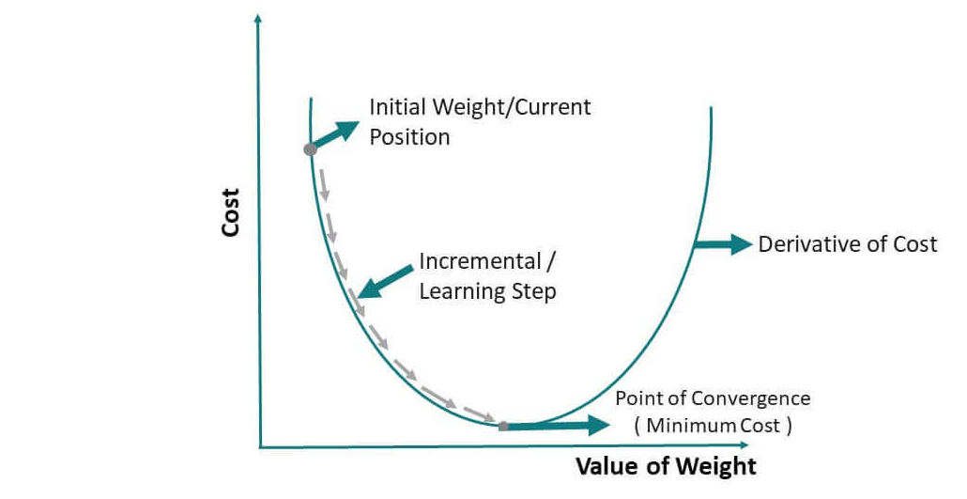
Gradients Leading to Optimization
9.2. Gradients.

Slide 13
What Engineers Need to Know about Gradients
Understanding the Basics: Engineers should have a firm grasp of basic calculus, particularly derivatives and partial derivatives, as they form the components of gradients
Computing Gradients Efficiently: Knowledge of efficient computation techniques like backpropagation is vital for handling complex neural network architectures
Managing Vanishing & Exploding Gradients: Familiarity with issues such as vanishing and exploding gradients and strategies to mitigate them are critical
9.2. Gradients.

Slide 14
What Engineers Need to Know about Gradients
Applying Adaptive Learning Rates: Engineers should know how to implement adaptive learning rate algorithms like AdaGrad, RMSProp, and Adam for efficient optimization.
Experimenting and Tuning: Practical experience in experimenting with different optimization strategies and tuning hyperparameters is essential for model optimization.
9.2. Gradients.

Slide 15
9.2
Forward Propagation.

Slide 16
What is Forward Propagation?
Forward Propagation involves passing the input data through each layer of the neural network to compute the output
It is the initial step in the learning process
It determines the initial predictions of the network
9.2. Forward Propagation.

Slide 17
Mechanics of Forward Propagation
Weighted Sum: This is calculated at each neuron based on weights and connections to the previous set of neurons
Activation Function: Applied to the weighted sum to introduce non-linearity
Non-linearity creates a boundary between each of the layers so that they cannot be simplified
9.2. Forward Propagation.

Slide 18
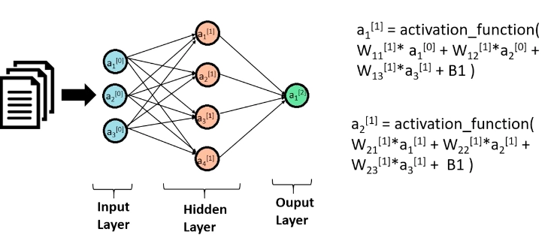
Forward Propagation
9.2. Forward Propagation.

Slide 19
9.3
Loss Function.

Slide 20
Introduction to Loss Functions
Loss Functions measure the disparity between the actual and predicted outputs
They guide the optimization of neural networks
Loss functions differ for every different task of
MSE for regression
Cross-Entropy for classification
9.3. Loss Function.

Slide 21
Importance of Loss Functions
Tuning Weights & Biases: Directly influences the adjustment of parameters
Model Performance: A lower loss indicates better performance
9.3. Loss Function.

Slide 22
Types of Loss Functions
Mean Squared Error (MSE) Loss
Primarily used for regression problems and model fitting, where the goal is to minimize the average of the squares of the errors between predicted and true values.
Cross-Entropy Loss
Employed in binary and multiclass classification tasks, where the objective is to minimize the dissimilarity between the predicted probability distribution and the true distribution.
9.3. Loss Function.

Slide 23
Types of Loss Functions
Categorical Cross-Entropy Loss
Used in multiclass classification problems, particularly in neural networks, as a generalization of cross-entropy loss for scenarios with more than two classes
Log-cosh Loss
Serves as an alternative to MSE for regression problems, providing a smoother error gradient by measuring the logarithm of the hyperbolic cosine of the prediction error
9.3. Loss Function.

Slide 24
9.4
Backpropagation.

Slide 25
Introduction to Loss Functions
Backpropagation refers to the backward pass of a neural network
During backpropagation the weights and biases are adjusted to minimize loss
It computes gradients of loss functions and updates the parameters
9.3. Loss Function.

Slide 26
Introduction to Loss Functions
Backpropagation refers to the backward pass of a neural network
During backpropagation the weights and biases are adjusted to minimize loss
It computes gradients of loss functions and updates the parameters
9.3. Loss Function.

Slide 27
Essential Knowledge on Backpropagation for Engineers
Learning Rate: Understanding the impact of the learning rate on convergence is crucial, as it influences the step size in the weight updates.
Weight Updates: Familiarity with how weights are adjusted based on computed gradients is essential for tuning and optimizing neural networks.
9.3. Loss Function.

Slide 28
Essential Knowledge on Backpropagation for Engineers
Vanishing & Exploding Gradients: Awareness of issues such as vanishing and exploding gradients, along with mitigation strategies like normalized initialization and gradient clipping.
Computational Efficiency: Knowledge of efficient computation techniques and libraries/frameworks that implement backpropagation is beneficial.
9.3. Loss Function.

Slide 29
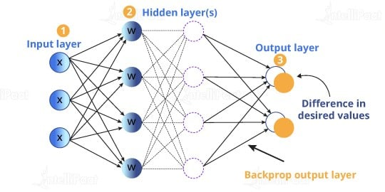
Back Propagation
9.3. Loss Function.

Slide 30
9.5
Building a custom model.

Slide 31
Building Layers in PyTorch
In PyTorch, neural networks are constructed using layers.
Layers are building blocks that process data as it flows through the network.
Each layer type serves a specific purpose in feature extraction and transformation.
9.5. Building a custom model.

Slide 32
Types of Layers in PyTorch
Linear layers: Transform input by linearly combining input features.
Convolutional layers: Capture spatial hierarchies in images.
Recurrent layers: Process time series and sequential data.
Activation layers: Introduce non-linearities into the network (e.g., ReLU, Sigmoid).
9.5. Building a custom model.

Slide 33
Training loop essentials
Forward pass: Compute the predicted outputs.
Compute loss: Measure the error.
Backward pass: Compute gradients.
Update weights: Apply optimization algorithm.
9.5. Building a custom model.

Slide 34
Concepts to keep in mind
Epochs: An epoch represents one complete pass through the entire training dataset.
Batch size: Number of samples processed before updating the model.
Iterations: Number of batches needed to complete one epoch.
Learning rate: Step size at each iteration while moving toward a minimum of the loss function.
9.5. Building a custom model.

Slide 35
END.

